Slide 1

HANDWRITTEN DIGIT RECOGNITION
GAURAV CHAUHAN (202410116100073)
HARSH SOLANKI (20241016100087)
DIVYAM RAJ (202410116100066) Under the Supervision of :-
GAURAV KUMAR (202410116100074) Prof. Apporv Jain Sir

Slide 2
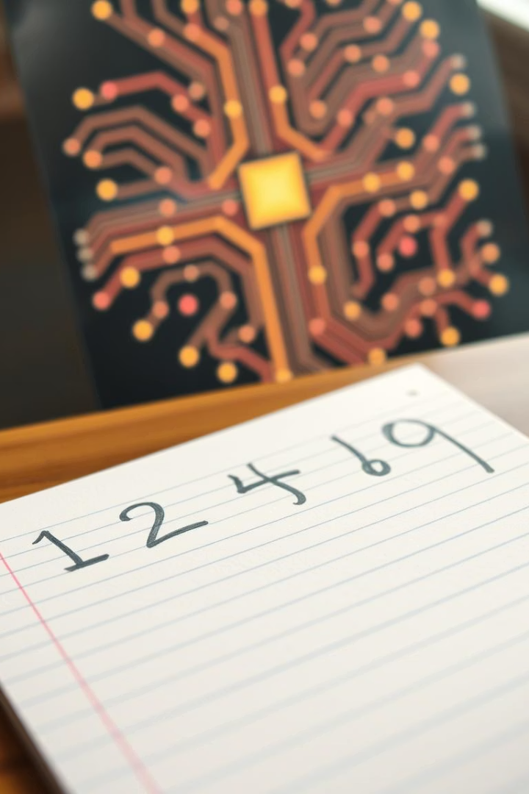


Handwritten Digit Recognition Project
This project explores recognizing handwritten digits using AI techniques. It's part of the AI Fundamentals course guided by our expert AI teacher. Our team is dedicated to building an accurate model that understands handwritten input effectively.
by Divyam Raj

Slide 3

Background and Motivation
Real-World Applications
MNIST Dataset
Historical Context
Essential for postal code sorting, check processing, and automating data entry tasks.
Contains 60,000 training and 10,000 testing handwritten digit images.
Transition from manual to automated recognition has revolutionized data processing.

Slide 4
Methodology: Data Preprocessing
Image Normalization
Data Augmentation
Centering and scaling digits to a consistent size improves model learning.
Rotation
Scaling
Grayscale Conversion
Translation
Shearing
Reducing to single channel simplifies input without losing detail.
Data Split
Training data is 80%, validation 20%, ensuring robust performance evaluation.

Slide 5





Methodology: Model Architecture
Convolutional Layers
Extract spatial features using learned filters.
Pooling Layers
Reduce dimensionality and computation load.
Fully Connected Layers
Integrate features for final digit classification.
Activation & Optimization
ReLU and Adam optimizer ensure efficient learning.

Slide 6
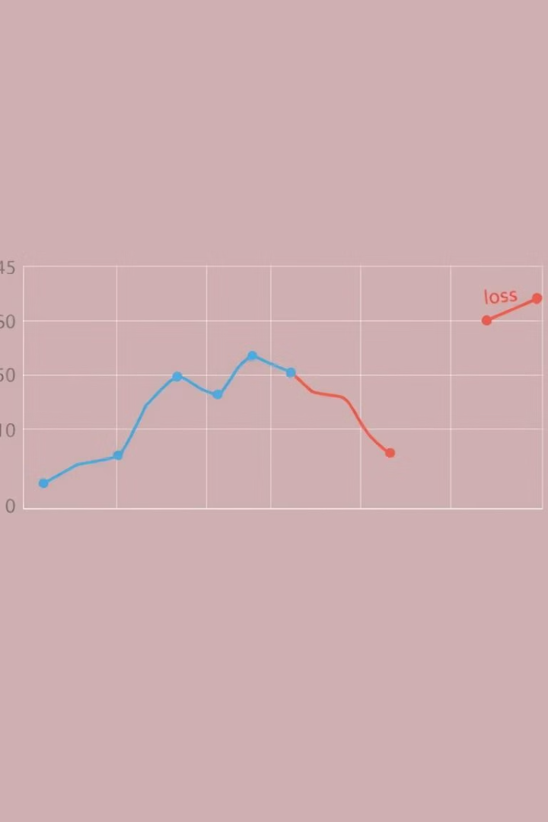
Training and Validation
Parameters
Monitoring
Batch size, learning rate, epochs tuned for best output.
Use accuracy and loss curves to track training progress.
Validation
Validate to avoid overfitting using early stopping criteria.

Slide 7
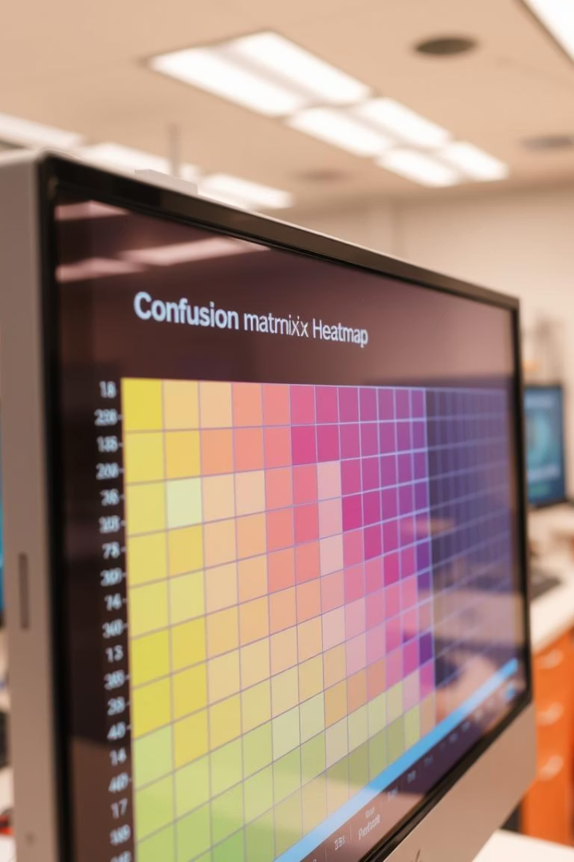



Results and Evaluation
Test Accuracy
Achieved high accuracy demonstrating effective digit recognition.
Precision & Recall
Balanced scores across digits ensure reliable classification.
Misclassifications
Examples highlight challenging digits and guide improvements.

Slide 8




Challenges and Solutions
Vanishing Gradients
Overfitting
1
ReLU activations and batch normalization helped stabilize training.
Data augmentation and dropout layers reduced this issue.
2
Time Constraints
4
Resource Limits
Focused on key features and streamlined coding practices.
3
Optimized batch size and model complexity for efficiency.

Slide 9

Conclusion and Future Work
Acknowledgements
Future Directions
Grateful to our AI teacher and team members for support.
Lessons Learned
Explore advanced architectures, improve accuracy, and real-time use.
Project Summary
Importance of robust preprocessing and model tuning.
Successfully built an accurate handwritten digit recognition model.

